Slide 1


AI Training
Estimation 1hour

Slide 2
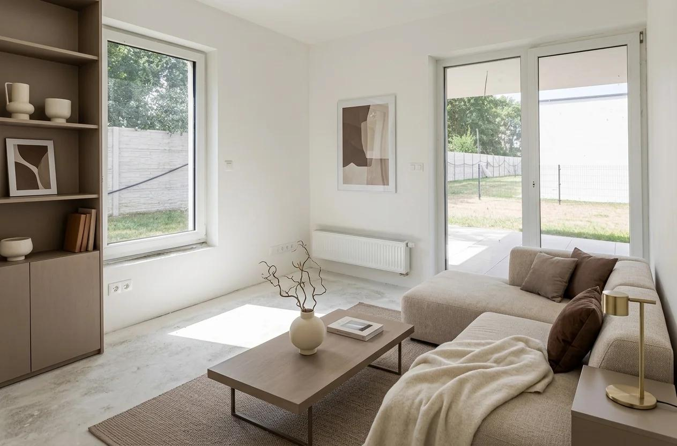
Virtual Staging using ChatGPT
Teach agents to transform:
Empty apartments
Vacant condos
Landed homes
Show units
Office spaces
into professionally

Slide 3
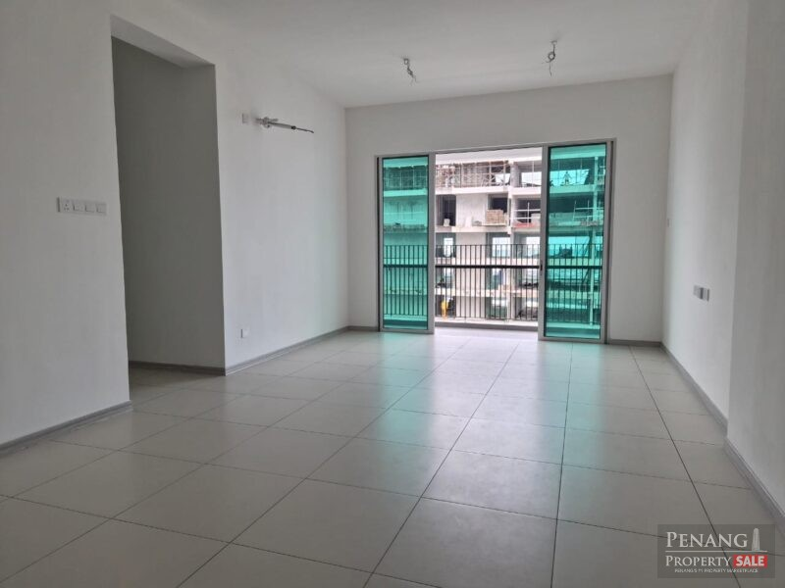
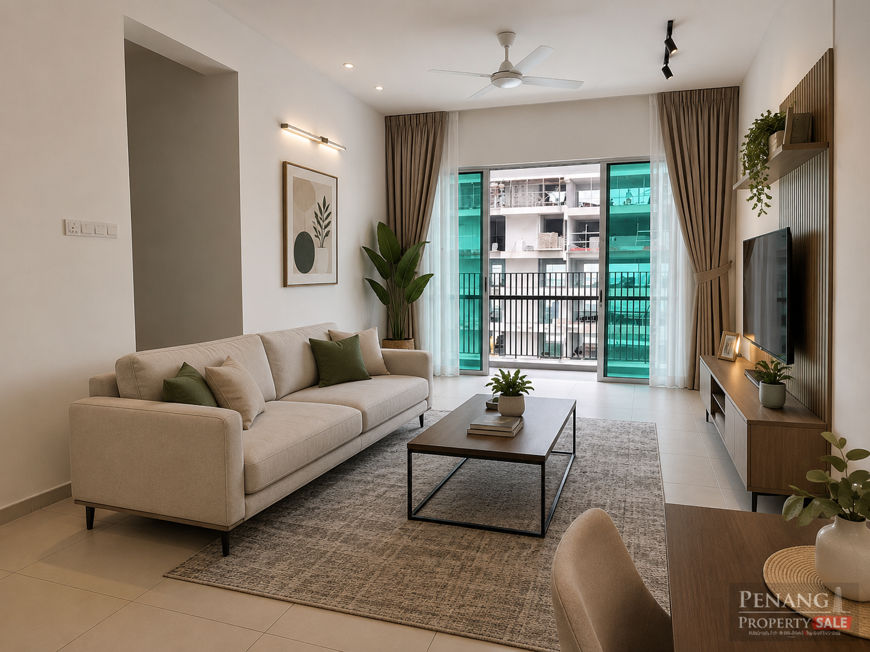
Living Hall
Before
After
Prompt: Can you furnish the living hall with furniture

Slide 4
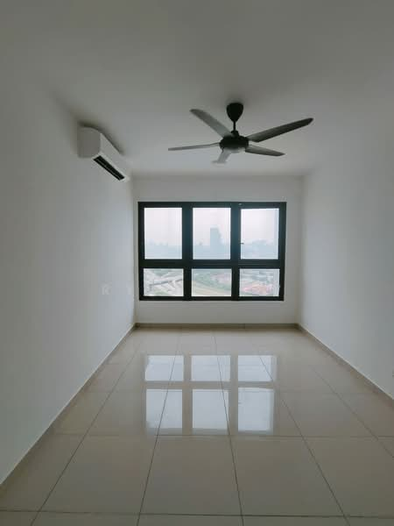
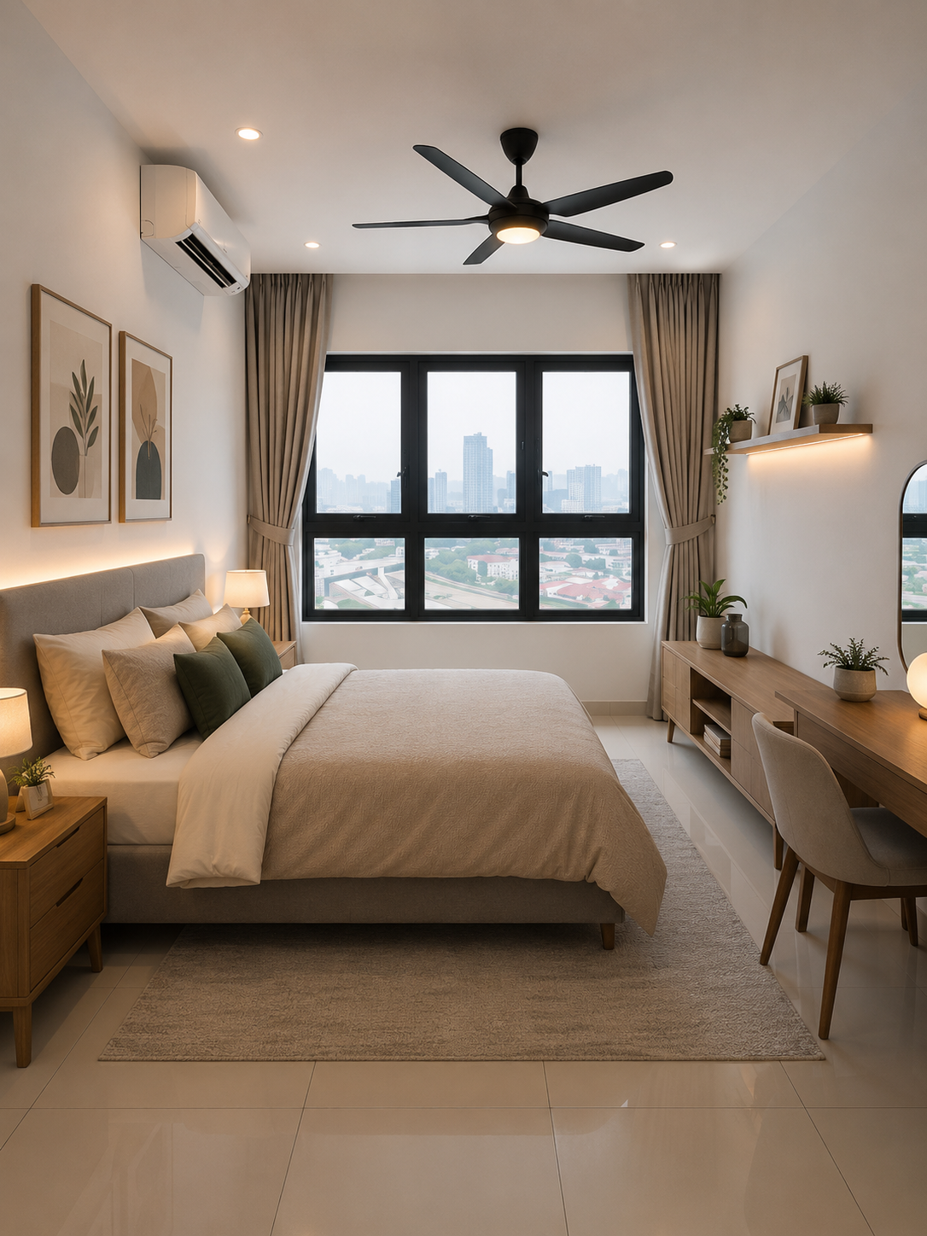
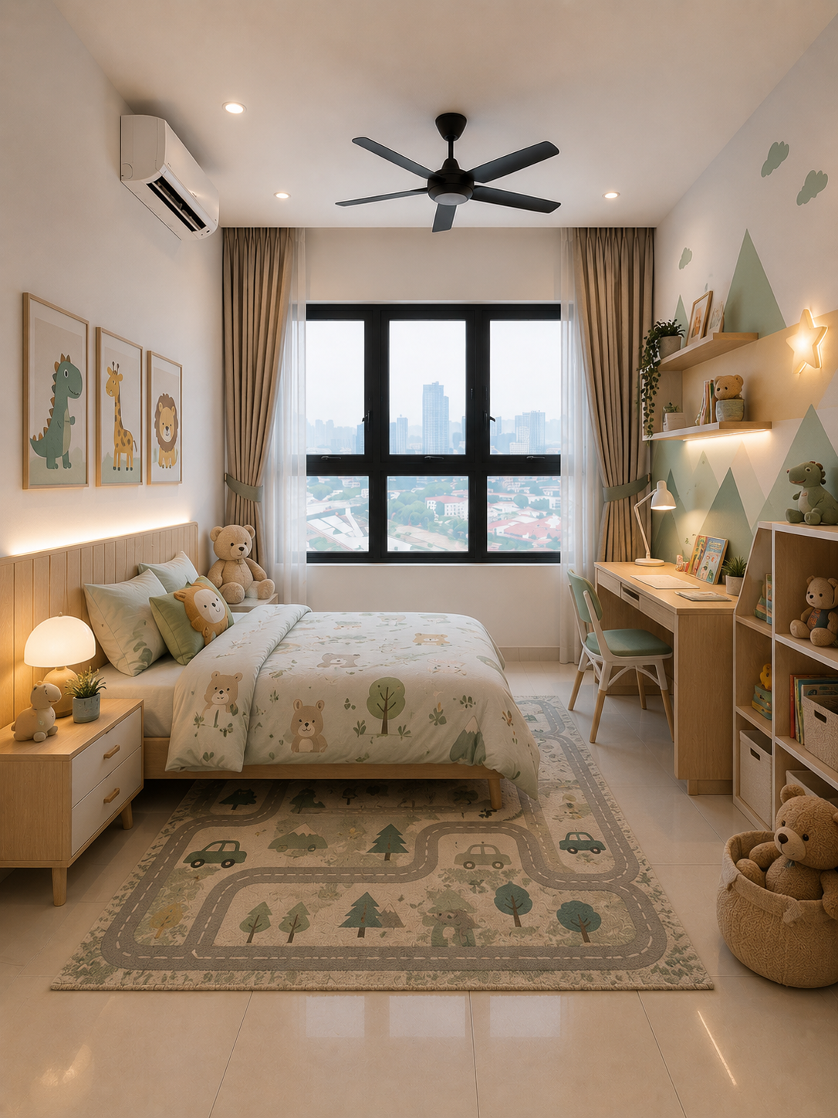
Room Unit
Prompt: Can you furnish the living hall with furniture
Prompt: Can you give a version to turn this into kids room

Slide 5
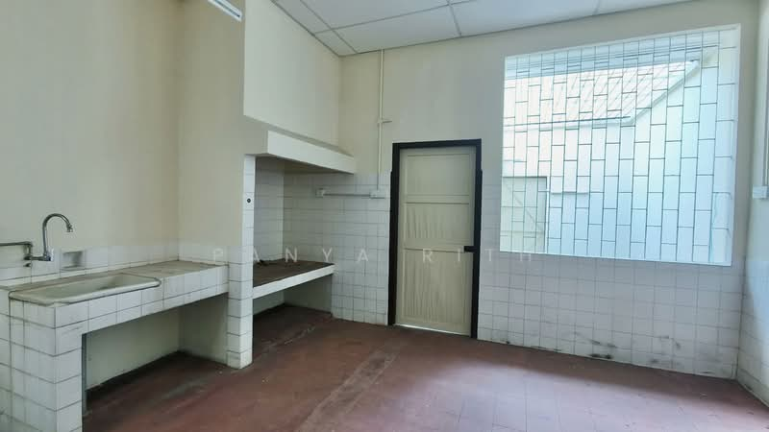
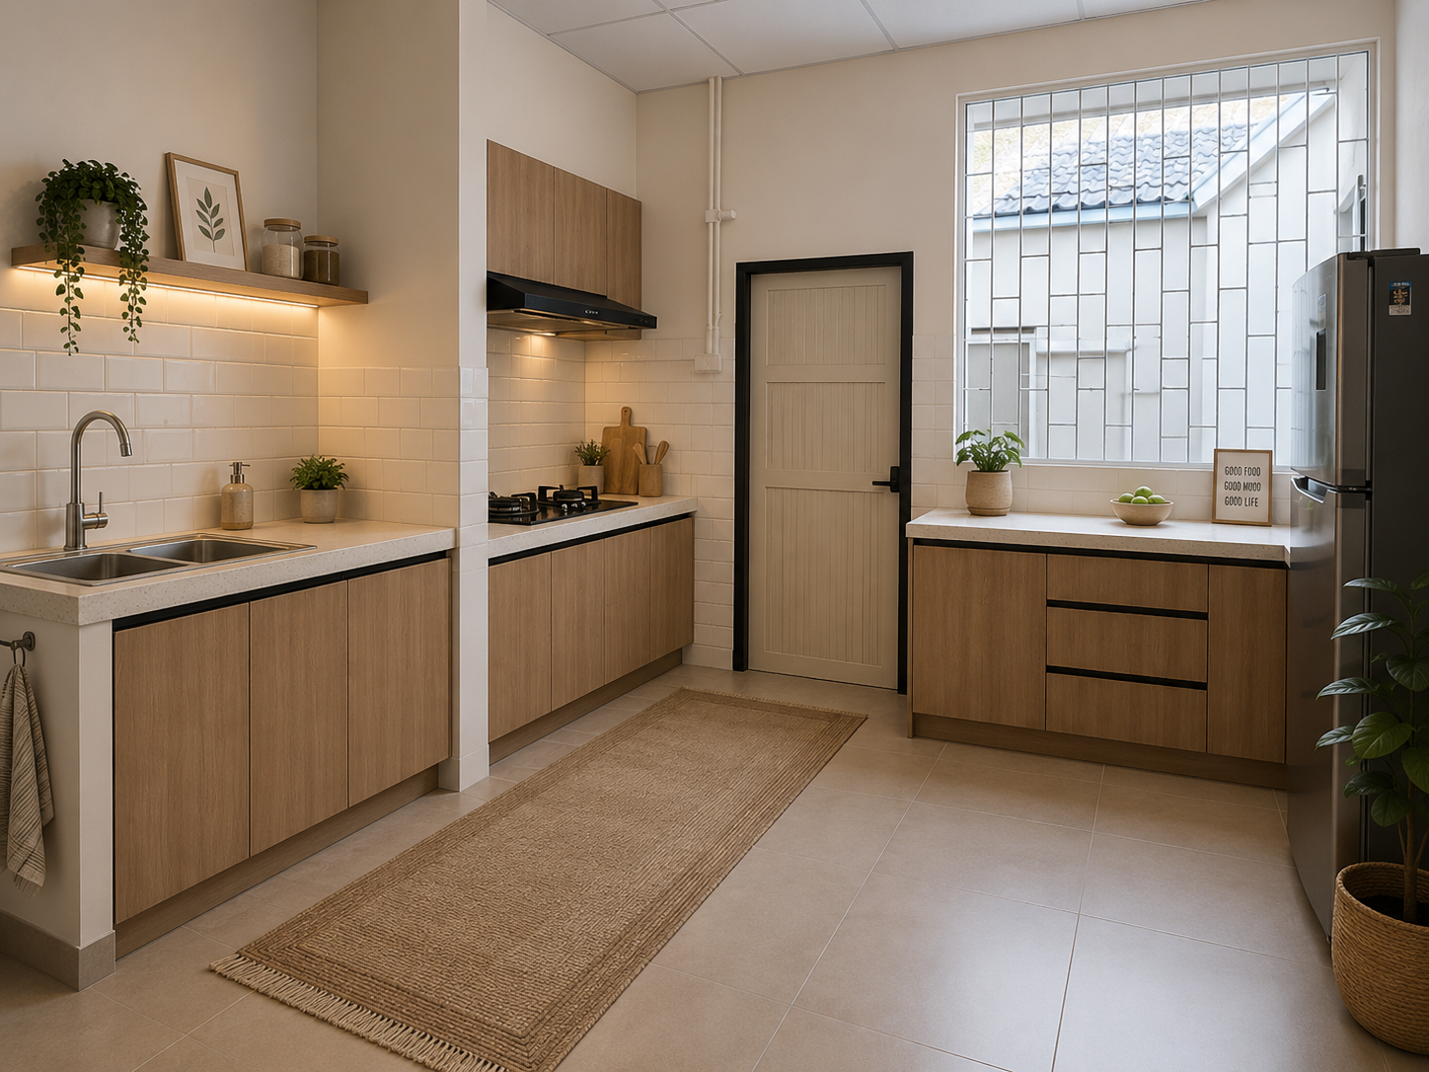
Kitchen Area
Prompt: Can you furnish this kitchen

Slide 6
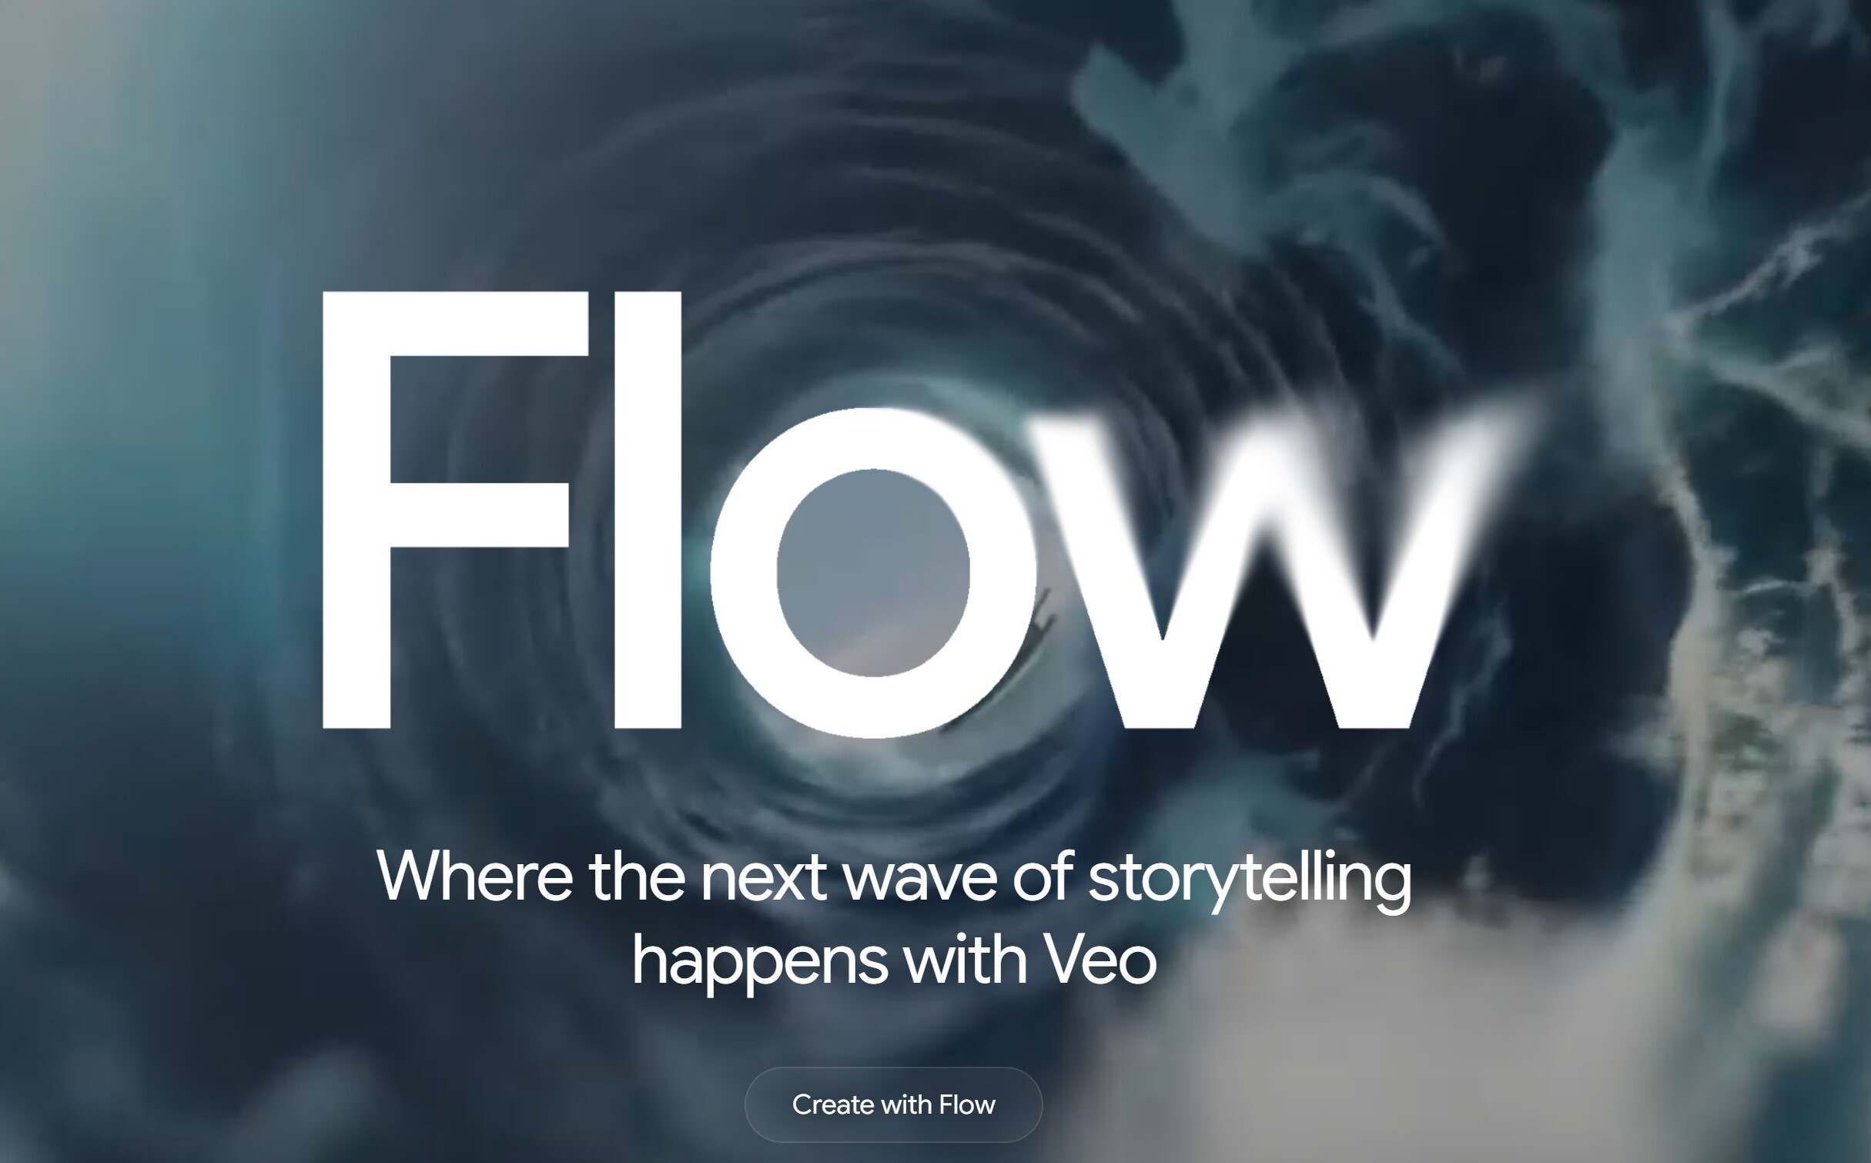
Google Flow
Video Creations for Video Staging
JSON
{
"title": "Korean Couple Apartment Tour",
"style": "cinematic, realistic, warm lighting, modern apartment",
"characters": [
{
"id": "couple",
"description": "Young Korean couple in casual modern clothing. Male wearing beige sweater and jeans. Female wearing soft cream outfit. Happy and excited expression."
}
],

Slide 7

Step 1
Generate two images
1) Create a staging image of a vacant unit and furnish it
2) Create another image of model, make sure you have a theme. Is this property for couple/family/successful entrepreneur and etc.

Slide 8
Creating JSON using ChatGPT
{
"title": "Korean Couple Apartment Tour",
"style": "cinematic, realistic, warm lighting, modern apartment",
"characters": [
{
"id": "couple",
"description": "Young Korean couple in casual modern clothing. Male wearing beige sweater and jeans. Female wearing soft cream outfit. Happy and excited expression."
}
],
"scenes": [
{
"step": 1,
"scene_name": "Entering the Living Room",
"location": "Modern furnished apartment living hall",
"action": "The Korean couple slowly walks into the living room together. They look around with excitement and admiration. The woman smiles while pointing at the interior design and the man nods happily.",
"camera": {
"shot": "wide angle",
"movement": "slow tracking shot following from behind"
},
"environment": {
"lighting": "warm afternoon sunlight entering through windows",
"mood": "cozy, welcoming, luxurious"
},
"duration_seconds": 5
},
How to Generate JSON File
“I would like to create a video using Google flow. Can you create a JSON format for my video.
Step 1: The couple walk into the room Step 2: The couple turn on the
television “

Slide 9
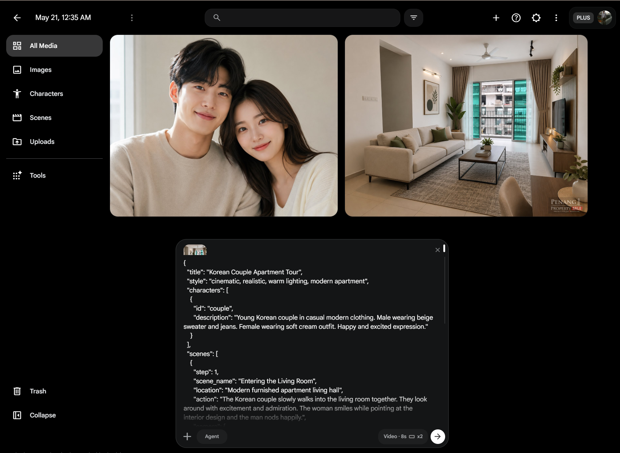
Insert JSON Prompt

Slide 10
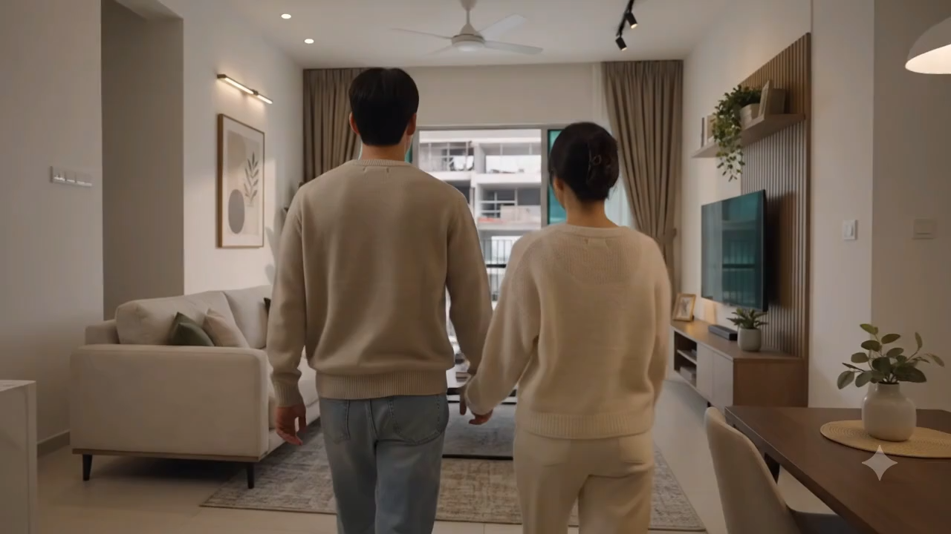

Slide 11
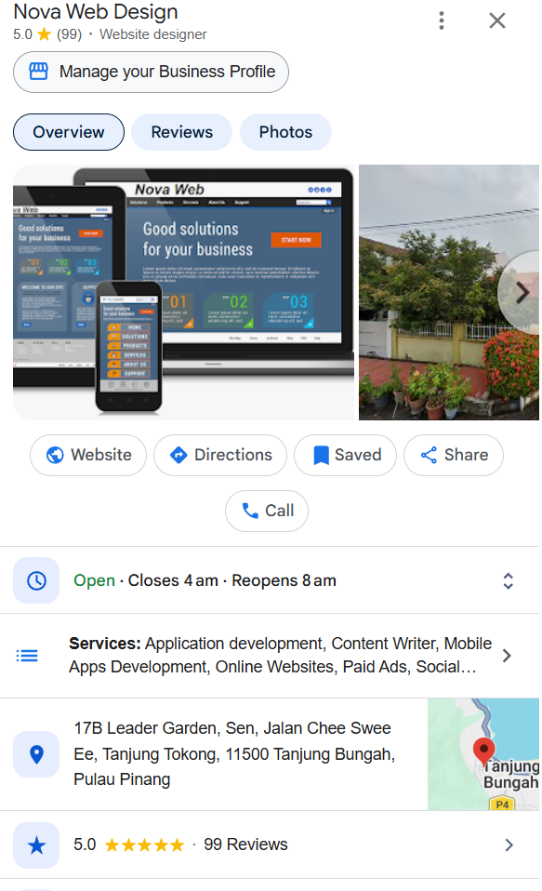

Nova Web
Please help to give me a 5 Star Review
Step 1: Go to www.google.com
Step 2: Type Nova Web Design Penang Tanjung
Bunga
Step 3: Click and Review
If you are keen and interested in this slides.
Just PM Me
012-4594388

Slide 12
What else to learn in AI World
Module 1: Social Media
Social Media Content Generation
Generate one video and ads and POST TO 3 Social Media
Tik Tok
Youtube
Instgram
Module 2: Landing Pages
Prospecting via Landing Pages
How to get leads from effective landing page
Module 3: Whatsapp/Telegram
How to automate whatsapp and telegram for automation
Do you want your chatbot to do all the autoreply and prospecting
Module 4:
Leads Generation
How to scrap data from Linkedln and Facebook.
Imagine you have a beautiful property with the price of RM 500k. How can you blast our the info effectively

